Slide 1

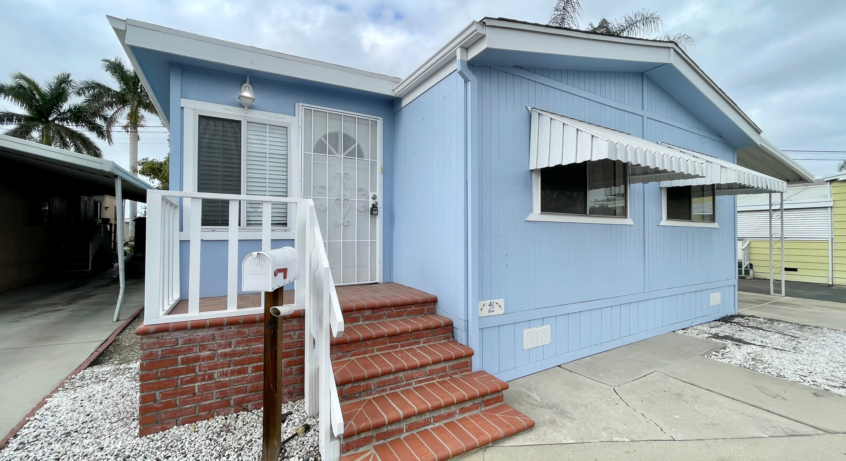

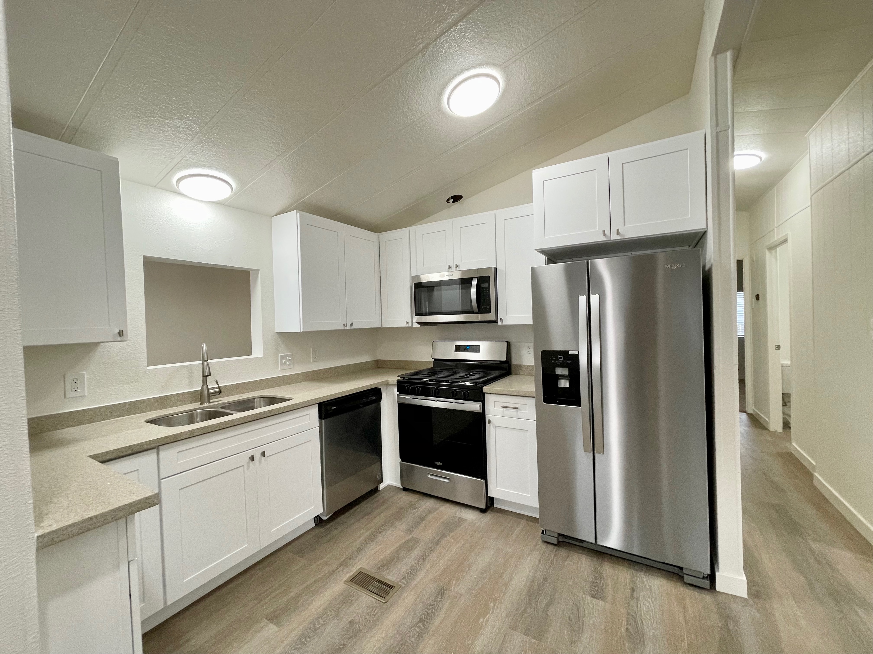

Rancho La Paz MHP
41 Elm Via, Anaheim, CA 92801
SCAN FOR DETAILS
SN: 23710612AS/BS
Call Peter Jorde at (949) 613-1044 to Schedule a Showing
THE PROPERTY
PROPERTY FEATURES
Gorgeous Remodeled 2 Bedroom Home For Rent
Great 55+ Community!
Very Low Rent for the Area
This Home is a Must See
Call Today!! (949) 613-1044
Year Built: 1983
1,000 sq. ft. Approx.
1 Story
2 Bedrooms
2 Bathrooms
Custom Remodel
All New Vinyl Plank Flooring
Great Kitchen w/All New Stainless Steel Appliances
Beautiful Quartz Countertops
All New Cabinets
Fresh Paint Inside & Out
Laundry Rm with Washer/Dryer
PETER JORDE
Mobile Home Dealer
(949) 613-1044
Peter@SouthCoastMobileHomes.com
Lic. # DL1505568
Space Rent only $$1,260
Information contained herein is deemed to be reliable but is not guaranteed

